Slide 1
THEME 2: TRADITIONS
Lesson 1
Lesson 3
Lesson 5
Lesson 2
Lesson 4

Slide 2
i-Learn Smart World – Theme 2
Page 14

Slide 3
i-Learn Smart World – Theme 2
garlic
salt
?
?
?
groom
?
wear
?
bride
carry
?
?
throw
Page 14
Notes:
Step 1: Teach the new vocabularies
Step 2: Fill in the blanks
Step 3: Check the answers

Slide 4
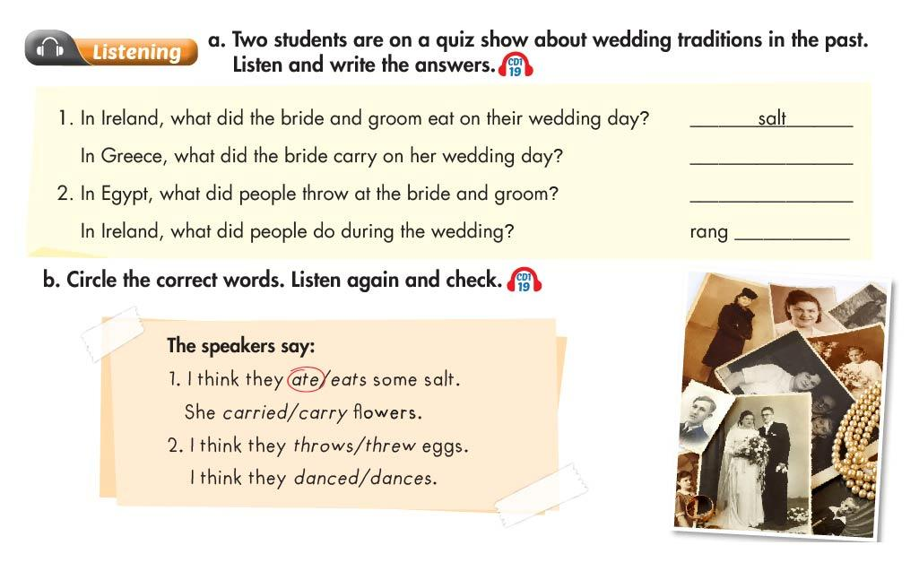
i-Learn Smart World – Theme 2
garlic
?
eggs
?
?
a bell
Page 14
Notes:
Step 1: Talk about the traditions
Step 2: Listen, fill in the blanks and check
Step 3: Listen again, choose the answers and check

Slide 5
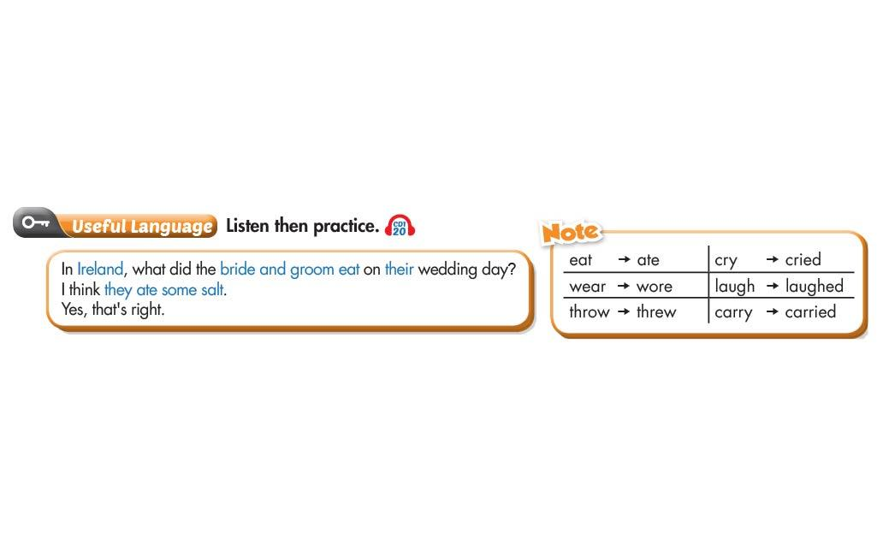
i-Learn Smart World – Theme 2
Page 14
Notes:
Step 1: Teach the past tense
Step 2: Listen for the answers
Step 3: Practice in pairs

Slide 6
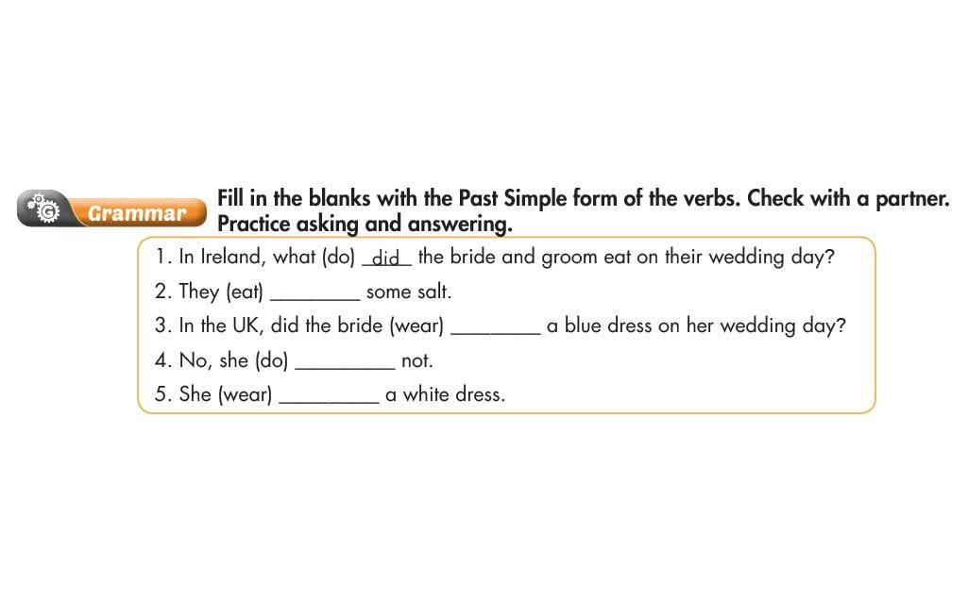
i-Learn Smart World – Theme 2
ate
?
?
wear
?
did
?
wore
Page 15
Notes:
Step 1: Review the vocabularies
Step 2: Do the exercise
Step 3: Check the answers

Slide 7
i-Learn Smart World – Theme 2
Page 15
Notes:
Step 1: Teach the vocabularies
Step 2: Listen and choose the answer
Step 3: Listen again and repeat

Slide 8
i-Learn Smart World – Theme 2
Page 15
Notes:
Step 1: Explain the rules
Step 2: Demonstrate one time
Step 3: Practice in pairs

Slide 9
i-Learn Smart World – Theme 2
Page 16

Slide 10
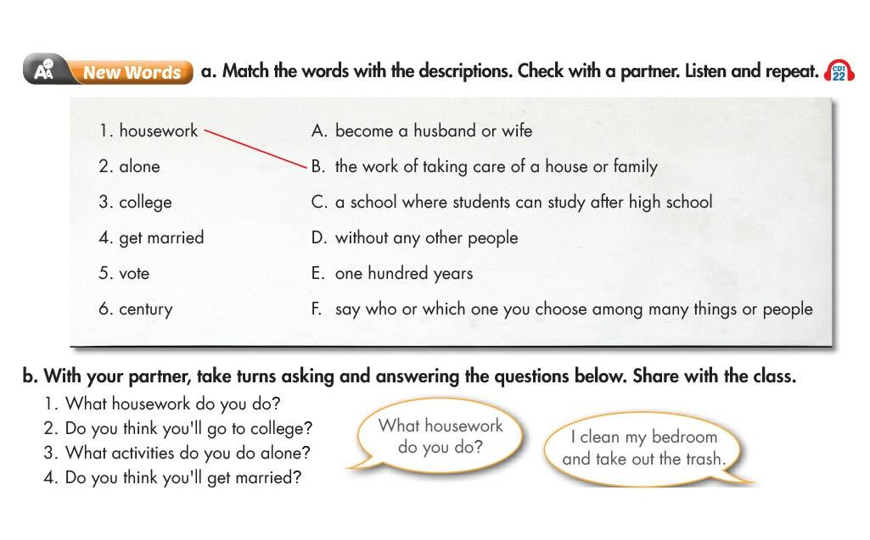
i-Learn Smart World – Theme 2
Page 16
Notes:
Step 1: Teach the vocabularies and match
Step 2: Ask some students to give answers to Exercise b
Step 3: Students practice in pairs

Slide 11
i-Learn Smart World – Theme 2
Page 16
Notes:
Step 1: Talk about the topic
Step 2: Listen, choose the answers and check
Step 3: Listen again, choose the answers and check

Slide 12
i-Learn Smart World – Theme 2
Page 16
Notes:
Step 1: Teach the grammar
Step 2: Listen for the useful language
Step 3: Call some students for class practice

Slide 13
i-Learn Smart World – Theme 2
Page 17
Notes:
Step 1: Review the grammar
Step 2: Choose the answers
Step 3: Check the answers

Slide 14
i-Learn Smart World – Theme 2
Page 17
Notes:
Step 1: Practice intonation
Step 2: Listen and mark the stress words
Step 3: Listen again, choose the answers and practice in pairs

Slide 15
i-Learn Smart World – Theme 2
Page 17
Notes:
Step 1: Talk about the past
Step 2: Practice asking and answering
Step 3: Discuss in pairs

Slide 16
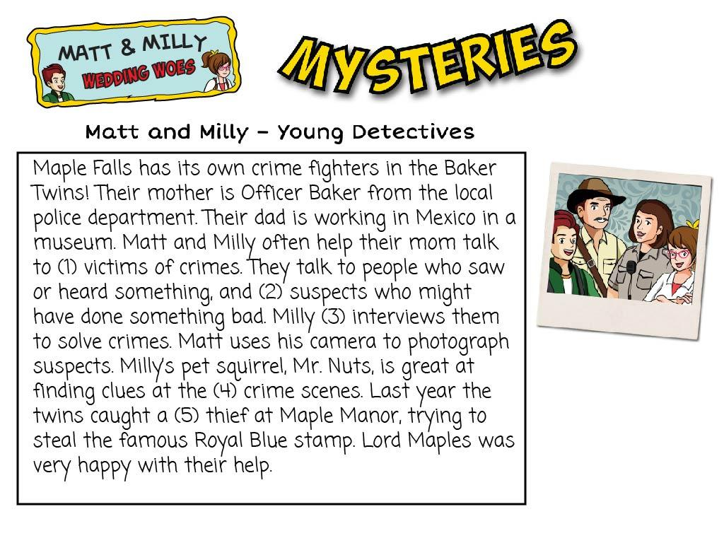
i-Learn Smart World – Theme 2
Page 18
Notes:
Step 1: Talk about the reading skills
Step 2: Let the students practice
Step 3: Check the skills

Slide 17
i-Learn Smart World – Theme 2
?
4
?
3
?
1
?
5
Page 18
Notes:
Step 1: Discuss the sentences
Step 2: Listen and match the words with their meanings
Step 3: Listen again, check and repeat

Slide 18
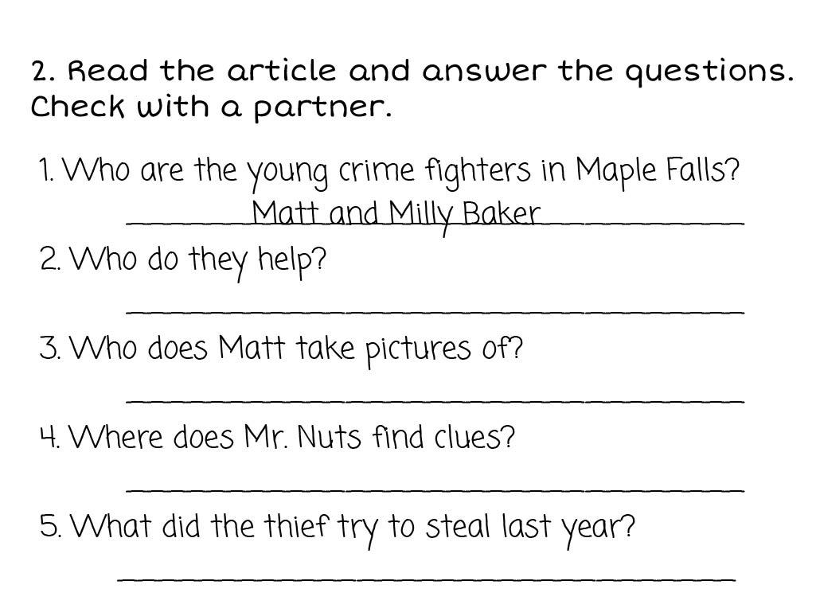
i-Learn Smart World – Theme 2
Their police officer mom
?
?
The suspects
?
At the crime scene
?
The famous Royal Blue Stamp
Page 18
Notes:
Step 1: Discuss the sentences
Step 2: Write the answers
Step 3: Check with partners

Slide 19
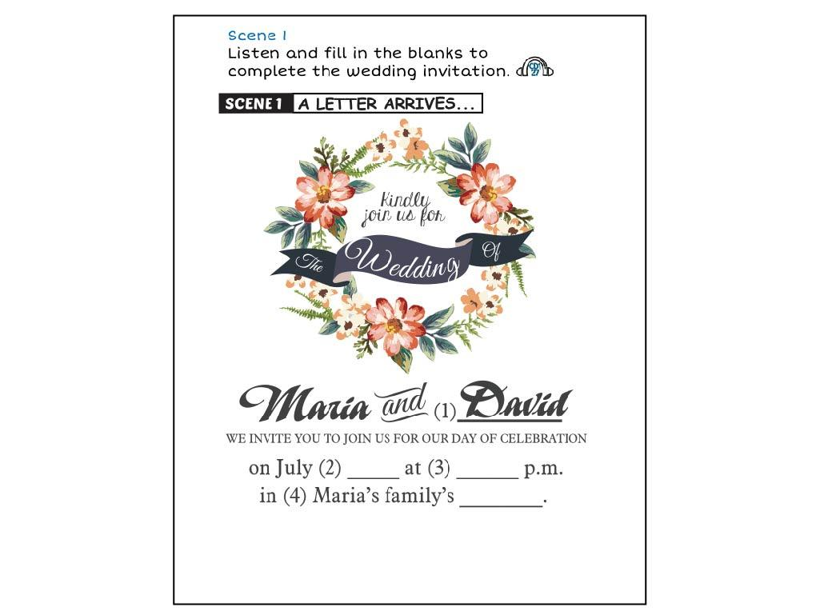
i-Learn Smart World – Theme 2
?
?
15th
4
garden
?
Page 18
Notes:
Step 1: Discuss the sentences
Step 2: Listen and write the answers
Step 3: Listen again, check and repeat

Slide 20
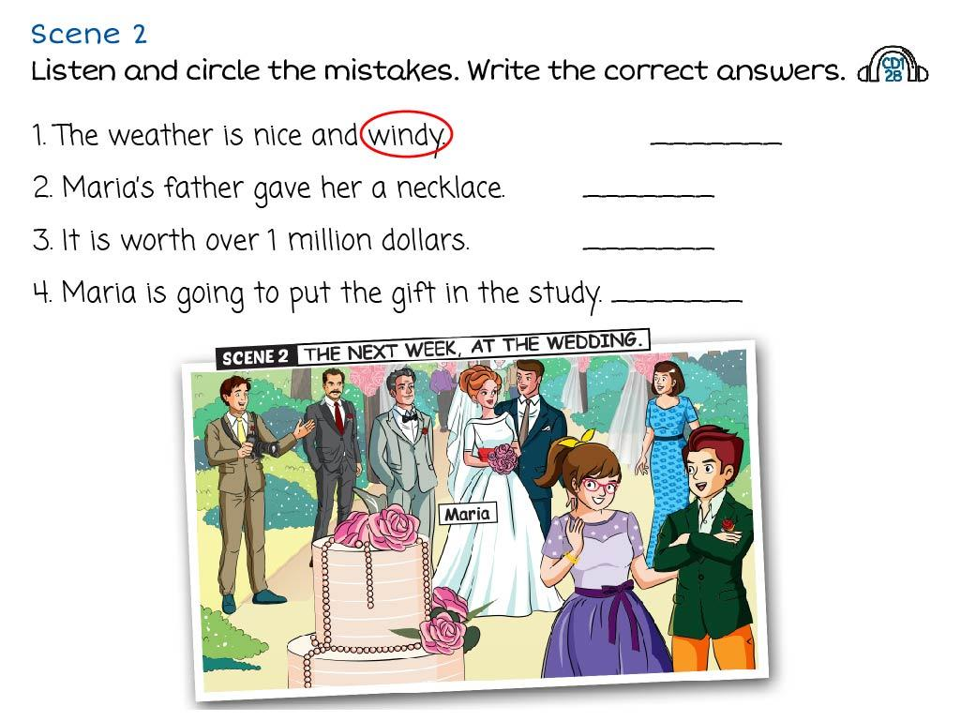
i-Learn Smart World – Theme 2
?
sunny
?
watch
?
100.000
?
her room
Page 18
Notes:
Step 1: Discuss the picture
Step 2: Listen and write the answers
Step 3: Listen again, check and repeat

Slide 21
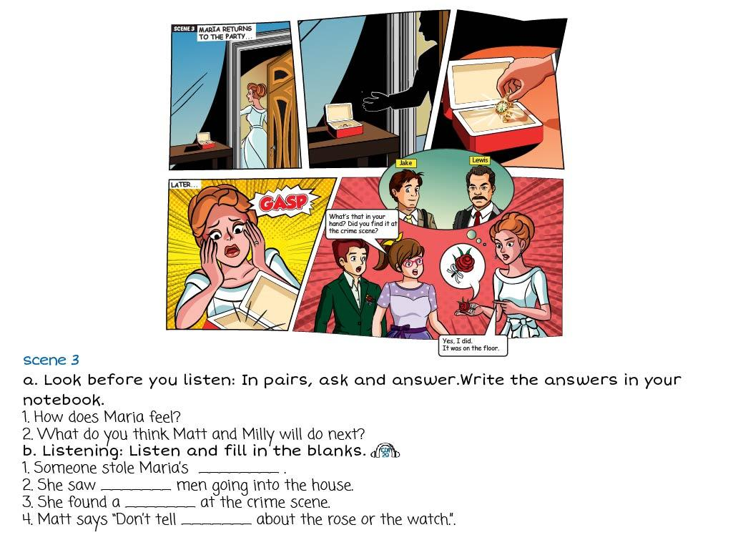
i-Learn Smart World – Theme 2
?
She feels suprise
?
They will talk to the two men in the picture
watch
two
?
?
rose
?
anyone
?
Page 19
Notes:
Step 1: Discuss the picture
Step 2: Ask and write the answers
Step 3: Listen, fill in the blanks and check

Slide 22
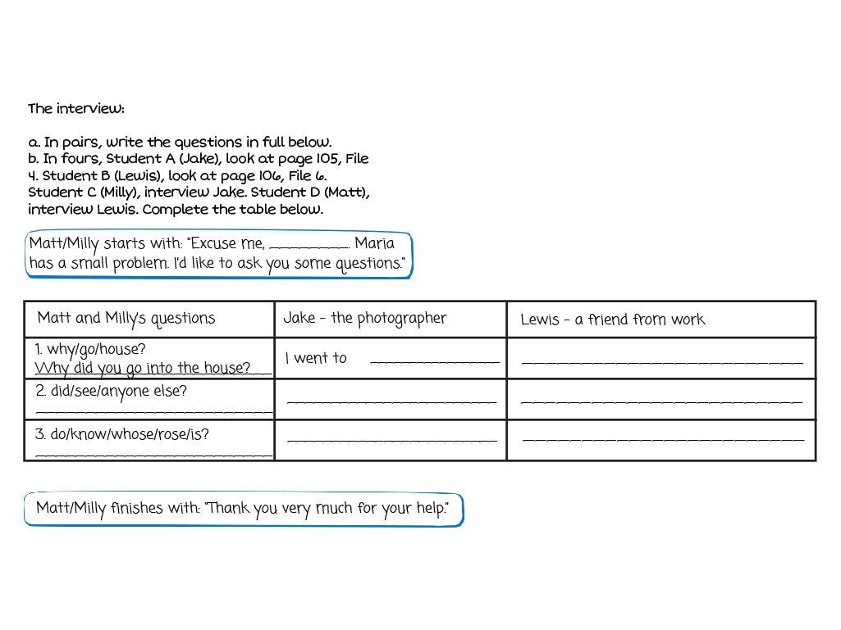
i-Learn Smart World – Theme 2
the bathroom
?
?
went to the bathroom
photographer
Maria
?
Did you see anyone else?
?
?
?
I don’t know. I think the thief must have dropped it on the floor
Do you know whose rose this is?
I don’t know
?
?
Page 19
Notes:
Step 1: Demonstrate the activity
Step 2: Write the answers
Step 3: Practice in pairs

Slide 23
i-Learn Smart World – Theme 2
?
Lewis
He knew the watch has been stolen
?
Because the watch worths $100.000
?
Page 19
Notes:
Step 1: Demonstrate the activity
Step 2: Discuss in pairs
Step 3: Each pair tells their opinion

Slide 24
i-Learn Smart World – Theme 2
Page 20

Slide 25
i-Learn Smart World – Theme 2
wind
?
stringed
?
?
bow
?
hitting
metal
?
blowing
?
?
bamboo
?
musical instruments
Page 20
Notes:
Step 1: Teach the vocabularies
Step 2: Listen and write the answers
Step 3: Listen again and check the answers

Slide 26
i-Learn Smart World – Theme 2
Page 20
Notes:
Step 1: First time just listen
Step 2: Second time circle “True” or “False”
Step 3: Listen again and check the answers

Slide 27
i-Learn Smart World – Theme 2
Page 20
Notes:
Step 1: Talk about Australia
Step 2: Talk about musical instruments
Step 3: Listen and check the answers

Slide 28
i-Learn Smart World – Theme 2
?
Sao truc: A Popular Vietnamese Instrument
?
?
bamboo
blowing
wind
?
farmers
?
Page 21
Notes:
Step 1: Talk about Vietnam
Step 2: Talk about musical instruments
Step 3: Write the answers and check

Slide 29
i-Learn Smart World – Theme 2
Page 21
Notes:
Step 1: Talk about musical instruments in the world
Step 2: Practice talking in pairs
Step 3: Write the answers and tell the class

Slide 30
i-Learn Smart World – Theme 2
?
Topic sentence
?
Body sentence 1
?
Body sentence 2
?
Body sentence 3
?
Conclusion
Page 21
Notes:
Step 1: Teach paragraph structure
Step 2: Write a paragraph
Step 3: Tell the class

Slide 31
i-Learn Smart World – Theme 2
Page 22

Slide 32
i-Learn Smart World – Theme 2
Page 22
Notes:
Step 1: Review the language
Step 2: Explain the rules
Step 3: Play the game

Slide 33
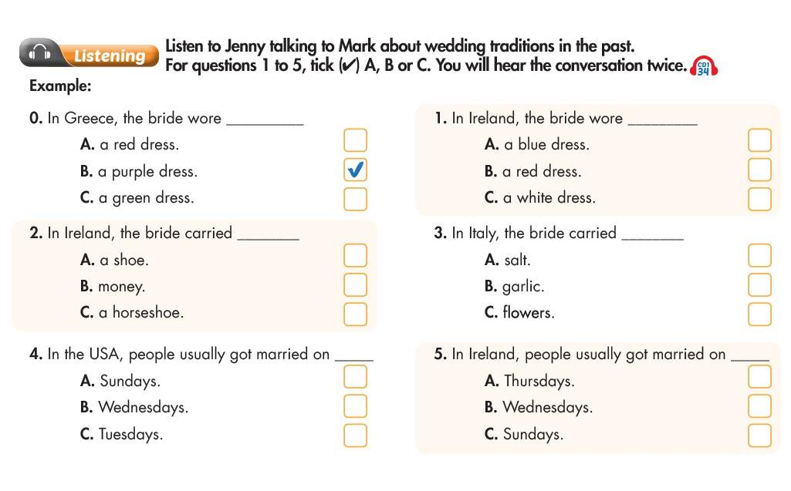
i-Learn Smart World – Theme 2
Page 22
Notes:
Step 1: Talk about wedding traditions
Step 2: Listen and tick
Step 3: Check the answers

Slide 34
i-Learn Smart World – Theme 2
Page 22
Notes:
Step 1: Discuss the topic
Step 2: Review the vocabularies
Step 3: Choose the answers and check

Slide 35
i-Learn Smart World – Theme 2
Page 23
Notes:
Step 1: Explain the rules
Step 2: Demonstrate the game
Step 3: Play in groups

Slide 36
i-Learn Smart World – Theme 2
Page 22
Notes:
Step 1: Practice reading skills
Step 2: Write a paragraph
Step 3: Tell the class

Slide 37
i-Learn Smart World – Theme 2
Page 105

Slide 38
i-Learn Smart World – Theme 2
Page 105

Slide 39
i-Learn Smart World – Theme 2
Page 106

Slide 40
i-Learn Smart World – Theme 2
Page 106

Slide 41
i-Learn Smart World – Theme 2
Page 118

Slide 42
i-Learn Smart World – Theme 2
Page 124

Slide 43
i-Learn Smart World – Theme 2
Page 125

